Slide 1
Fundamental
Data Types
COS 1020 C++ Programming
AUBG COS Department
Based on chapter 2 – problem solving, abstraction and design using C++, Friedman & Koffman

Slide 2
Lecture Contents
2.1 C++ Language Elements
2.2 Reserved Words and Identifiers
2.3 Data Types
2.4 Executable Statements
2.5 Program Style
2.6 Arithmetic Expressions
2.7 Common Programming Errors

Slide 3
Comments
Parts of the program that make it more understandable to the human reader, but are ignored by the compiler:
  Describe the purpose of the program
  Show the name of the author
// symbols indicate a line comment – apply to just the rest of the line
Block comments start with /* and end with */ – can span on multiple lines

Slide 4
Comment Examples
// declaring a variable and initializing it to 5
int a = 5;
a = 15; // updating the value of a
/* the next statement outputs
the value of a to the standard
output device – i.e. the monitor */
cout << a << endl;
/**********************/
//**********************

Slide 5
Listing 2.1: Converting Miles to Kilometers
#include <iostream>
using namespace std;
int main() // Start of main function
{
const float KM_PER_MILE = 1.609; // 1.609 kilometers in a mile
float miles, kms; // input: miles, output: kms
// Get the distance in miles
cout << "Enter the distance in miles: ";
cin >> miles;
// Convert the distance to kilometers
kms = KM_PER_MILE * miles;
// Display the distance in kilometers
cout << "The distance in kilometers is " << kms << endl;
return 0; // Exit the main function
}

Slide 6
#include <filename>
Compiler directive – a statement that is processed before the program is translated
Includes previously written code from a library into your program
For example:
  #include <iostream>
  Includes the iostream header from the C++ standard library that has operators for performing input and output

Slide 7
using namespace std;
Indicates to the compiler that this program uses objects defined in a standard namespace called std
The using statement must end with a semicolon
Follows #include directives in the code
Because the C++ standard library is defined in the std namespace, this line must appear in all programs that use it

Slide 8
Function main
Exactly one main function per program
A function is a collection of related statements that perform a specific operation
int indicates the return type of the function
() indicates no special information passed to the function by the operating system
int main()
{
// function
// body
return 0;
}

Slide 9
Types of Statements
Declaration statements – describe the data the function needs:
const float KM_PER_MILE = 1.609;
float miles, kms;
Executable statements – actions the program will carry out:
cout << "Enter the distance in miles: ";
cin >> miles;

Slide 10
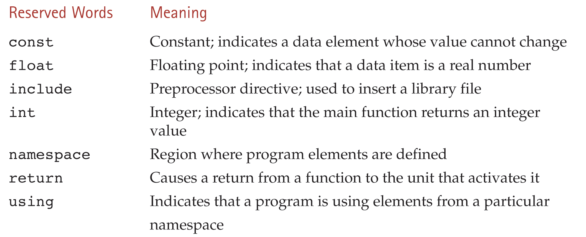
Reserved Words (Keywords)
Have special meaning in C++ and cannot be used for other purposes

Slide 11
Identifiers
Names for data and objects to be manipulated by the program
Must begin with a letter or underscore (not recommended)
Consists only of letters, digits, and underscores
Cannot be a reserved word
Case-sensitive (difference between upper and lower case letters)

Slide 12
Identifiers in Listing 2.1
Identifier Use
cin C++ name for standard input stream
cout C++ name for standard output stream
km Data element for storing distance in kilometers
KM_PER_MILE Conversion constant
miles Data element for storing distance in miles
std C++ name for the standard namespace

Slide 13
Data Types
Defines a set of values and operations that can be performed on those values
Integers
  Positive and negative whole numbers – e.g.: 5, -52, 343222
  short, int, long
  Represented internally in binary format
  Predefined constants line INT_MIN and INT_MAX

Slide 14
Data Types (continued)
Floating Point
  Real numbers has two parts – integral and fractional
  Examples: 2.5, 3.666666666, -.000034, 5.0
  float, double, long double
  10.0 and 10 are stored differently in memory

Slide 15
Data Types (continued)
Boolean
  Two possible values: true and false
  bool
  Can be used to represent conditional values needed by a program to make decisions

Slide 16
Data Types (continued)
Characters
  Represent individual character values – a letter, a digit or a special symbol that can be typed with the keyboard
  Examples: 'А' 'а' '2' '*' '"' ' '
  char
  Stored in 1 byte in memory
  Special characters – escape sequences – allow simple textual control: '\n' '\b' '\r' '\t' '\''

Slide 17
string Class
Besides the built-in data types, C++ provides definitions for a number of other data types in its standard library
The string class provides a type for performing operations on string data – compare, join, split, etc.
Examples: "Enter speed:" "ABC" "B" "1234"
For using string identifiers, but not required for literals:
  #include <string>

Slide 18
Variable Declarations
Portions of memory used for storing program data, such as its input or computed results, are called variables
A variable declaration statement tells the compiler the names (identifiers) of variables and the kind of information to be stored in each one
  type identifier-list;
Example:
  int age;

Slide 19
Variable Declaration Examples
float x;
int me, you;
float week = 40.0;
char letter = 'Y';
string flower = "rose";
std::string flower = "rose";

Slide 20
Constant Declarations
Constants are portions of memory whose contents cannot change
const type constant-identifier = value;
Example:
  const float KM_PER_MILE = 1.609;
Constant identifiers often contain only upper-case letters

Slide 21
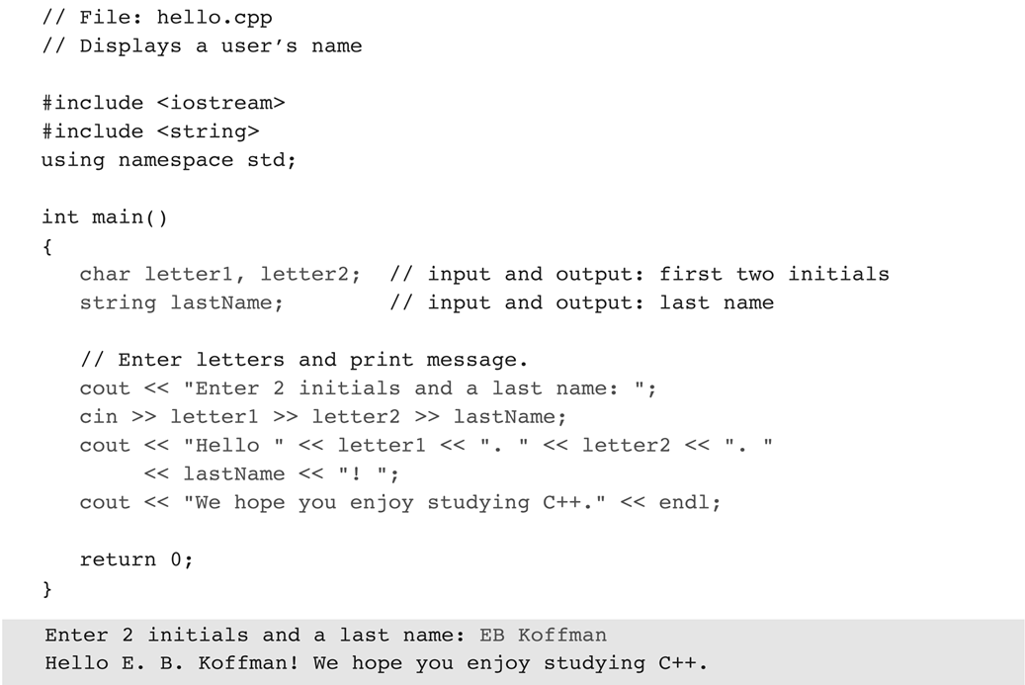
Listing 2.2: Printing a Welcome Message

Slide 22
Executable Statements
Statements that are translated into machine language instructions that are executed
Examples:
  Assignment statements
  Input statements
  Program output
  The return statement

Slide 23
Assignment Statements
A statement used to store a value or a computed result in a variable
variable = expression;
Examples:
kms = KM_PER_MILE * miles;
sum = sum + item;

Slide 24
Input Statements
Statements that read data from an input device into memory. Data is different each time the program is executed
Input (Extraction) operator >>
  cin >> data-store;
Examples:
cin >> miles;
cin >> age >> firstInitial;
Requires:
  #include <iostream>

Slide 25
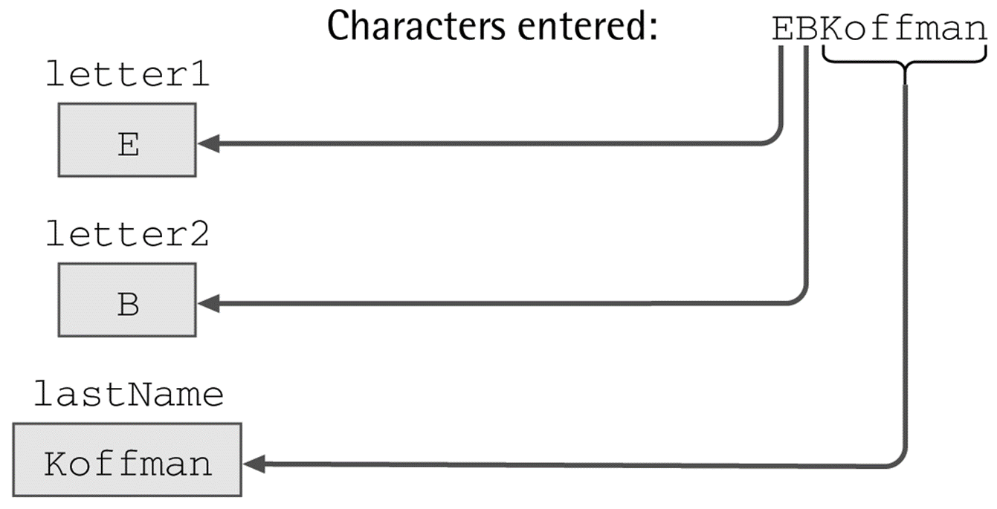
Input Statements (continued)
cin >> letter1 >> letter2 >> lastname;

Slide 26
Program Output
Displaying program data – prompts, results, etc
Output (Insertion) Operator <<
  cout << data-element;
Example:
  cout << "Height: " << height << endl;
If the value of height is 1.80, the output will be:
  Height: 1.80
endl (or '\n') causes a new line in output

Slide 27
The return Statement
Last line of the main function is typically:
  return 0;
That transfers control from the program to the operating system, indicating that no error has occurred

Slide 28
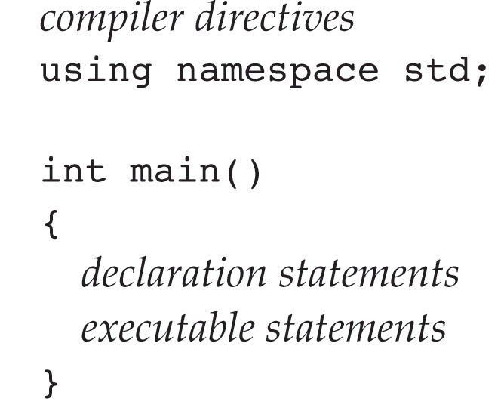
General Form of a C++ Program

Slide 29
Good Program Style
Use of spacing
  One statement per line
  Blanks after comma, around operators and between some lines
Use of comments
  header section
  document algorithm steps and describe difficult code
Identifier naming conventions
  Variables in all lower case, with initial capital letter for additional words. No underscore (camelCase)
  Constants in all upper case, with underscores between words

Slide 30
Arithmetic Expressions
Arithmetic operators:
  +, -, *, /, %
Integer division examples – result is integer
Examples:
  15 / 3 = 5
  15 / 2 = 7
  0 / 15 = 0
  15 / 0 undefined

Slide 31
Modulus for Integers
Used only with integers
Returns the integer remainder of the division
Examples:
  7 % 2 = 1
  299 % 100 = 99
  49 % 5 = 4
  15 % 0 undefined

Slide 32
Mixed-type Expressions
Contain operands of different types – e.g. int and float
Example:
  4.6 / 2 evaluates to 2.3
Rule: When an integer and a floating point operand are combined by an operator, the integer gets converted to the floating point type

Slide 33
Mixed-type Assignments
When an assignment statement is executed, the value on the right side is first evaluated and then assigned to the variable on the left side.
If the variable on left side of assignment is of different type than the type of the evaluated expression on the right side, the result of the expression must be converted to the appropriate type.

Slide 34
Mixed-type Assignment Examples
float a, b, x;
int m, n;
a = 10;
b = 3.5;
m = 5;
n = 10;
x = m / n;
m = b * 3;
10.0 is stored in variable a
0 is assigned to x
10 is assigned to m

Slide 35
Expressions with Multiple Operators
Unary operators – only one operand – e.g. negation
  -y
Binary operators – involving two operands
  x + z
Parentheses can be used to group expressions to be evaluated first
Example:
  z - (a + b / 2) + w * -y;

Slide 36
Order of Operator Precedence
(Highest to Lowest)
Parentheses – nested expressions are evaluated first
Unary –
*, /, %
Binary + and –
NOTE: Have to watch out for the types of operands and the type of the result from evaluating each operand!

Slide 37
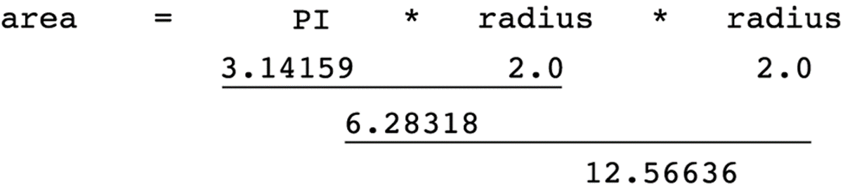
Step-by-Step Expression Evaluation

Slide 38
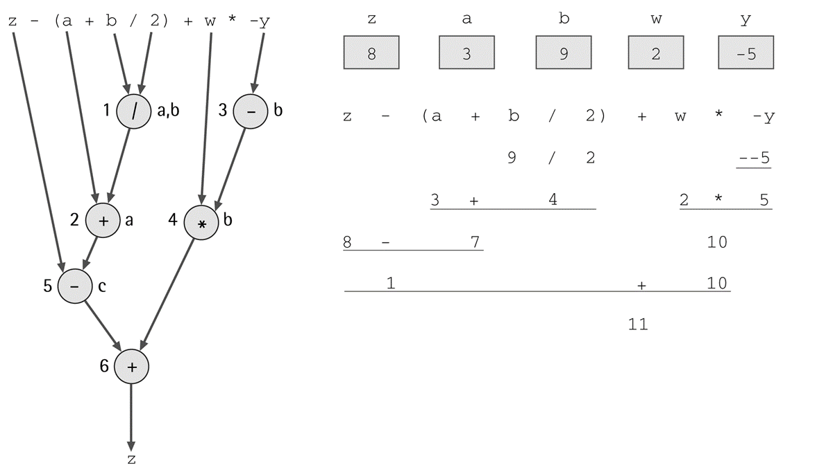
Evaluation of: z - (a + b / 2) + w * -y

Slide 39
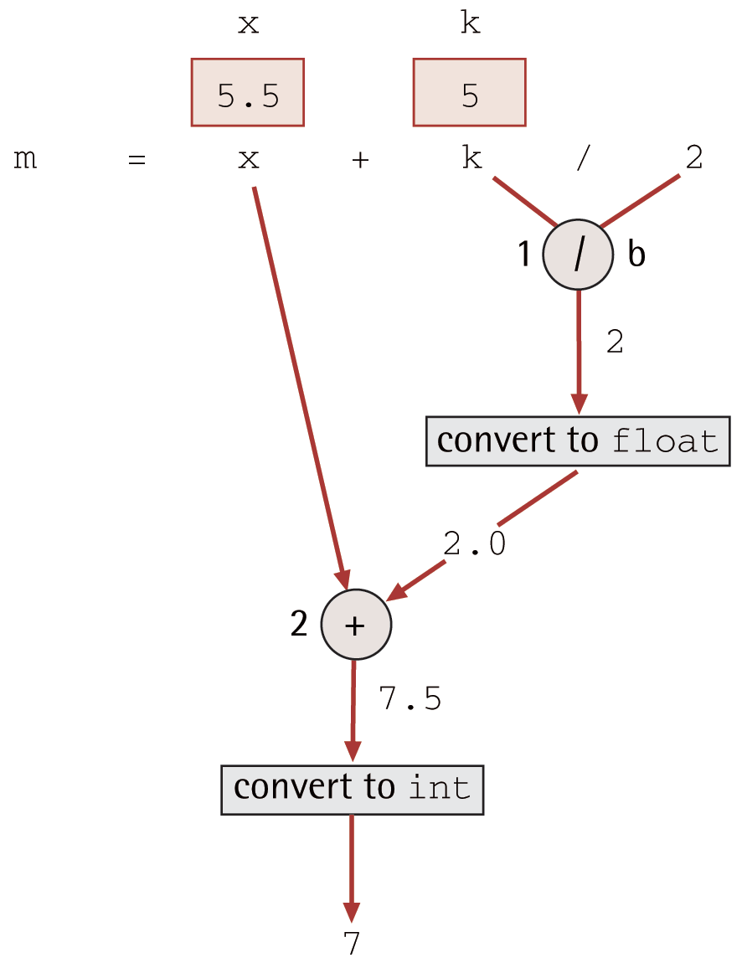
Evaluation Tree for: m = x + k / 2

Slide 40

Mathematical Formulas in C++
$a = bc$ – not valid C++ syntax
  Must use the * operator:
  a = b * c;
$m=\frac{y −b}{x −a}$
  Must use ( ) and /:
m = (y - b) / (x - a);

Slide 41
Common Programming Errors
Syntax Errors
  Violate the rules of the C++ grammar
  Detected by the compiler
  Prevent translation of the program into object code, so no execution is possible
  Contents and format of error messages are different across compilers

Slide 42
A Program with Syntax Errors
#include <iostream>
#include <string>
using namespace std;
int main()
{
string name;
cout << "What is your name: ; // missing quote
cin >> name;
cout << "Hello " << name << endl // missing semi-colon
return 0;
}

Slide 43
Compiler Output
source.cpp(10): error C2001: newline in constant
source.cpp(11): error C2146: syntax error: missing ';' before identifier 'cin'
source.cpp(14): error C2143: syntax error: missing ';' before 'return‘

Slide 44
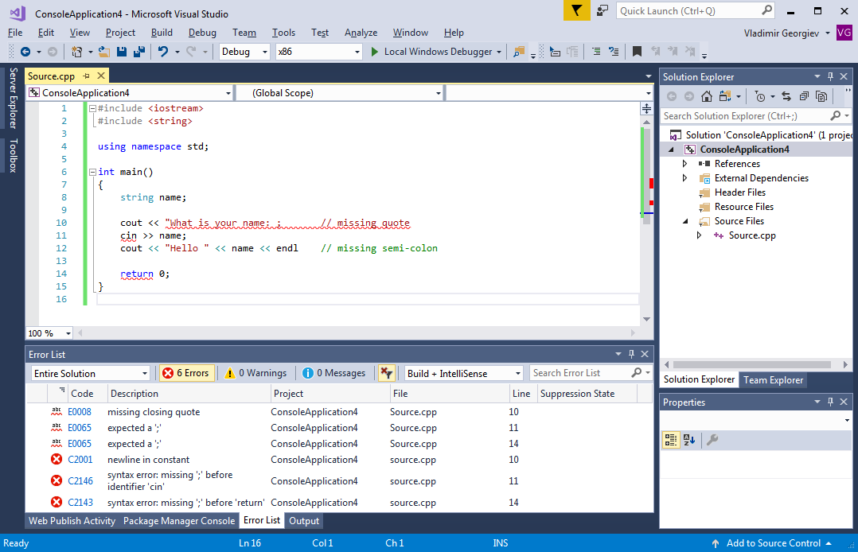
Visual Studio Error List

Slide 45
Common Programming Errors (continued)
Run-time Errors
  Errors detected by the computer during program execution
  When encountered, program execution stops and a diagnostic message is displayed

Slide 46
Common Programming Errors (continued)
Undetected Errors
  Program runs to completion, but results are incorrect
  Often the result of input of the wrong type being entered – e.g. a program expecting an integer input receives a string

Slide 47
Common Programming Errors (continued)
Logic Errors
  Caused by a faulty algorithm
  Often difficult to locate
  Can result in either a run-time or undetected error
  System cannot identify - up to programmer to locate
  To prevent such errors, plan your solutions carefully and test them to eliminate bugs early

Slide 48
Summary
Built-in data types (int, float, bool, etc):
float price;
price = base * 1.2;
User-defined data types (string):
  string name = "John Smith";
Input and output using cin and cout:
cout << "Enter your name: ";
cin >> name;

Slide 49
Summary (continued)
Arithmetic operators (+, -, *, /, %)
Integer division: float x = 5 / 10; // x is 0, not 0.5
Can have expressions with multiple operators:
  z - (a + b / 2) + w * -y;
Operator precedence:
  Parentheses – nested expressions are evaluated first
  Unary –
  *, /, %
  Binary + and –

Slide 50
Questions?
Q & A

